Slide 1
Classification Models for Road Safety Prediction
Student: Pak Him LEUNG AH KANG
Student ID: 500866890
Supervisor: Tamer Abdou
Date: Dec 02, 2024

Slide 2
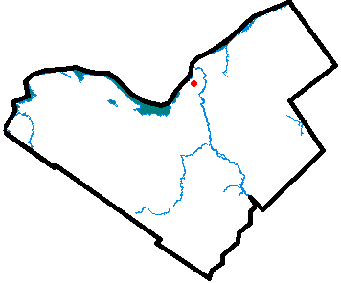
Introduction
This project focuses on the analysis of historical traffic collision data in Ottawa and identify patterns and trends that contribute to accidents and make predictions on accident hot spots

Slide 3
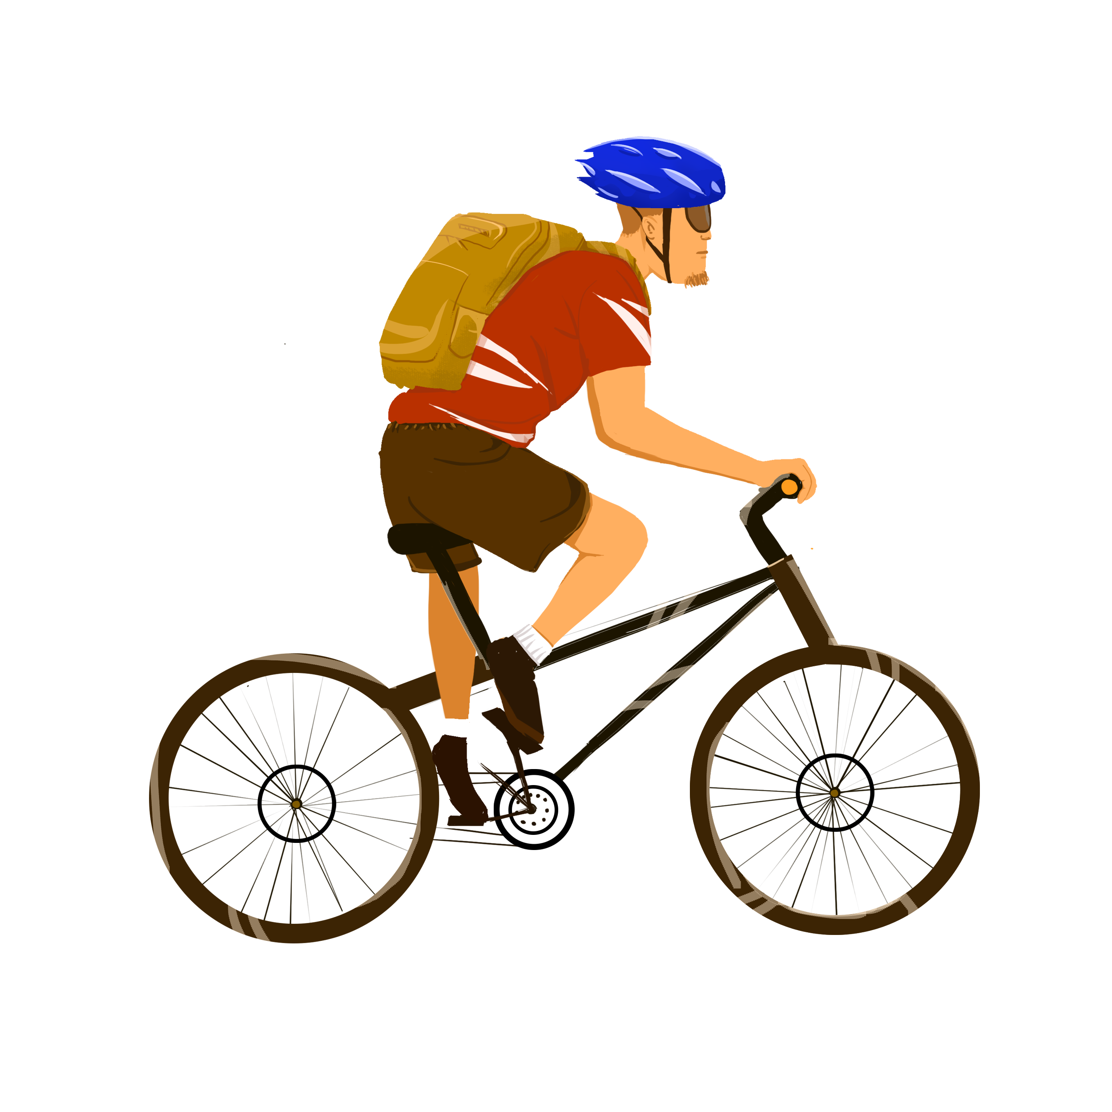
Objectives/Goals/Motivation
The motivation is to provide a useful tool for cyclists and drivers to learn about how safe their routes are.
The project aims to predict the chance of collision for a location accurately using historical traffic collision data

Slide 4
Research Questions
What are the factors that contribute most significantly to the amount of road collisions at a specific road or location? Does the speed of the vehicle influence the collision rate?
Which model can best accurately predict the most dangerous locations for road traffic collisions in Ottawa
How do road surface conditions like wet or snowy or icy affect the probability of road collisions at various locations? Does time of the day and days of the week affect the number of vehicular collisions?

Slide 5
Literature Review
Abohassan et Al. 2022 examines the positive relationship between pavement friction caused by snow and collision counts in Edmonton during inclement weather
Mahshid Eltemasi et Al. 2024 looked into the relationships between different causes of road accidents and found that distracted driving is the most significant cause of traffic collision
Perez et Al. 2007 determined that traffic cameras have an effect of traffic road collisions

Slide 6
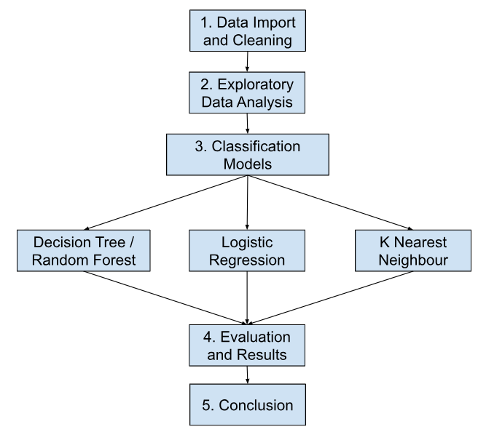
Approach

Slide 7
Data Preparation
The data is a csv file that can be downloaded from open.ottawa.ca
The dataset contains 74,612 rows and 30 column initially and have been reduced to 74467 rows and 14 columns
Columns have been dropped and columns that have less than 5 missing values have been replaced by a median value.
Removed 10 duplicated rows

Slide 8
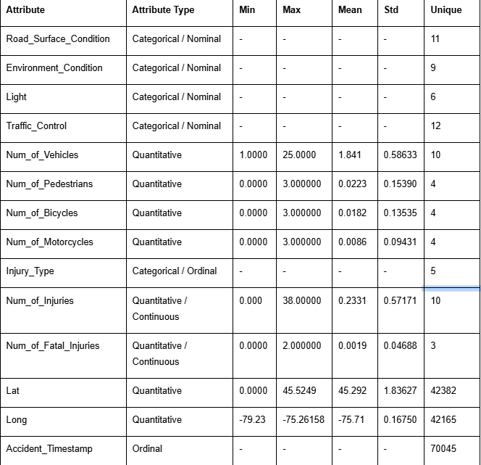
Data Description

Slide 9
Feature Engineering
Encoding
Collision boolean column will be created using Num_of_Injuries > 0
One Hot encoding due to low cardinality

Slide 10
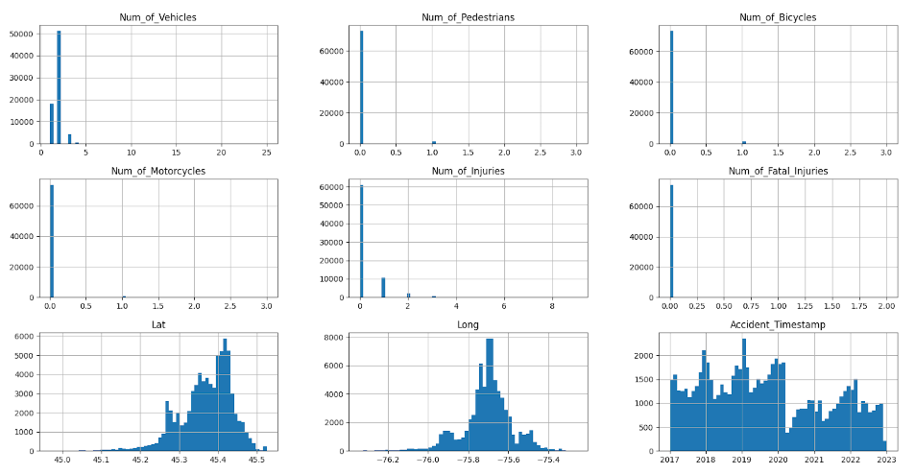
Exploratory Data Analysis (EDA)
Very Few outliers

Slide 11
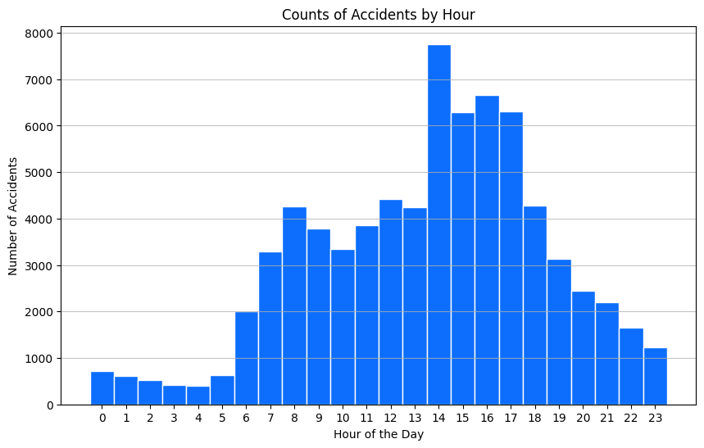
Trends: Accident count by hour

Slide 12
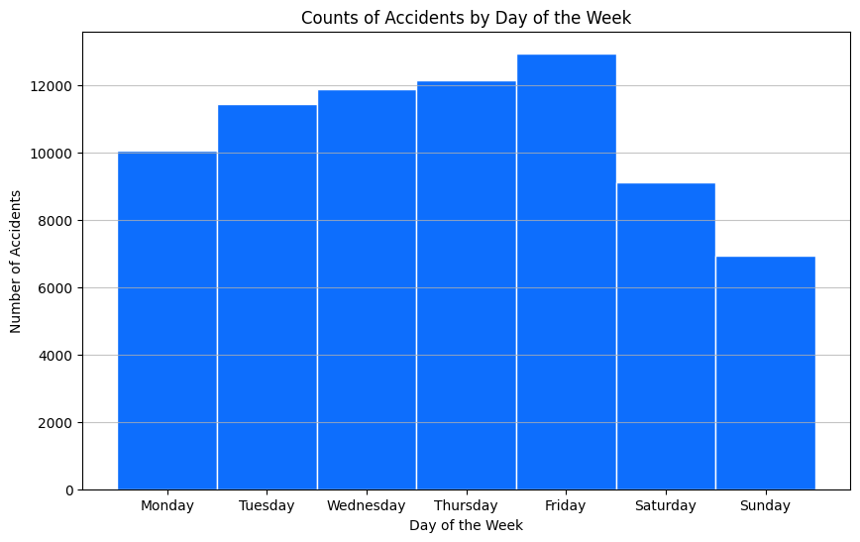
Trends: Accident Count by Day of the week

Slide 13
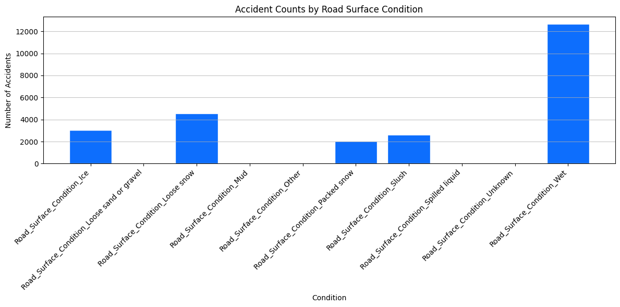
Trend: Accident Count by Road Surface Condition

Slide 14
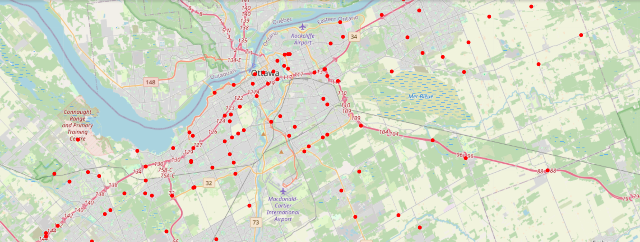
Fatal Injury Geospatial Map

Slide 15
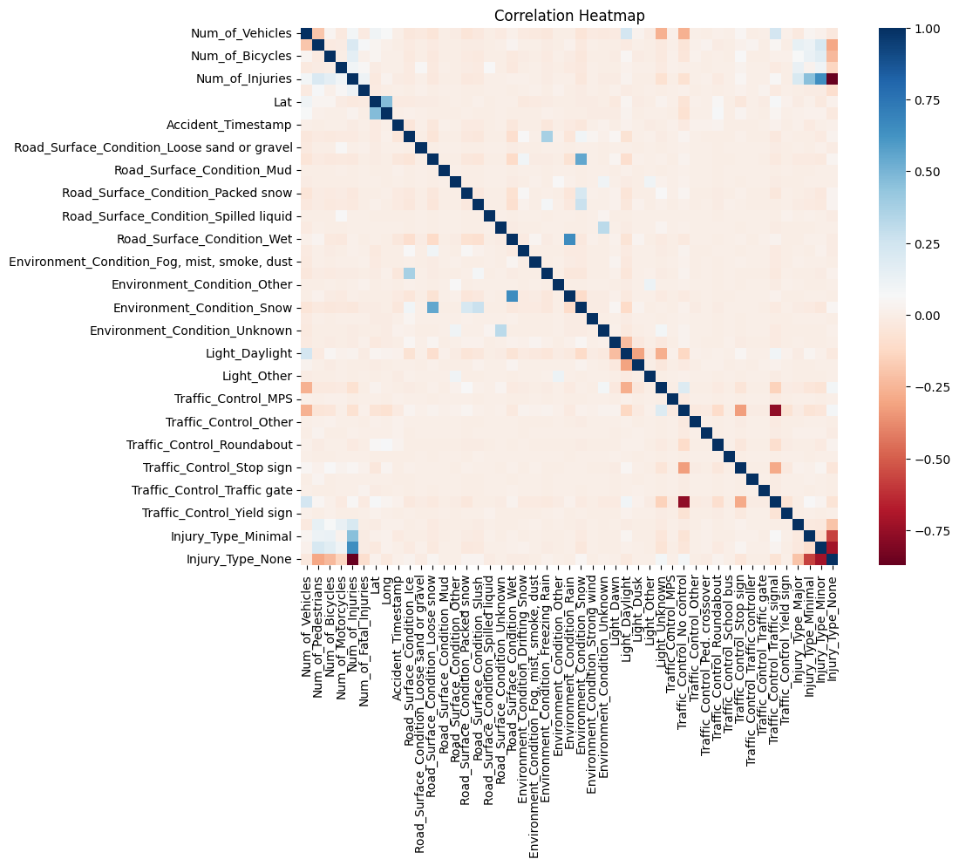
Correlation Heatmap
Strongest correlations between road surface condition and rainy weather

Slide 16
Classification Models
Split Data into 80% training and 20% test set
Choose target variable collision which is a boolean.
Run the following algorithms
Logistic Regression
Decision Tree
K Nearest Neighbor
Random Forest

Slide 17
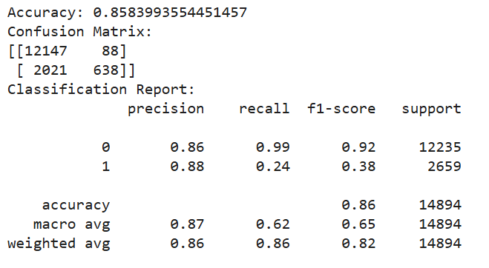
Logistic Regression
Performs well for “No collision” with 0.86 precision and 0.99 recall
Fails to identify Collisions with low recall

Slide 18
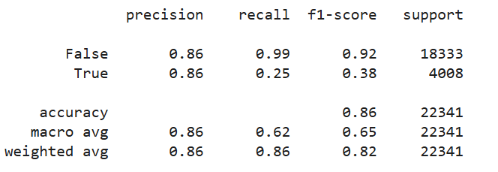
Decision Tree
Accuracy 86%, high precision means Model good at identifying non-collisions
but bad at detecting actual collisions (recall = 0.99)
Because of Support imbalance.
Solution: oversampling, undersampling, ensemble

Slide 19
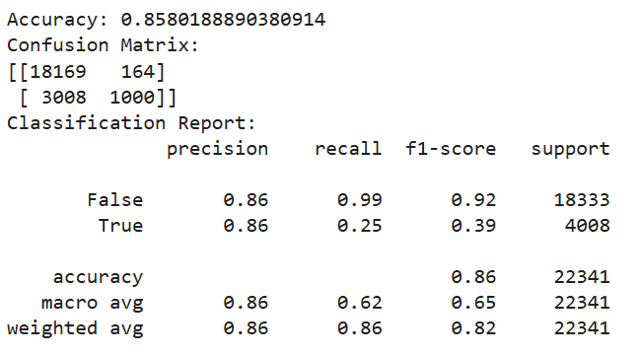
Random Forest
Same accuracy, precision and recall as decision tree

Slide 20
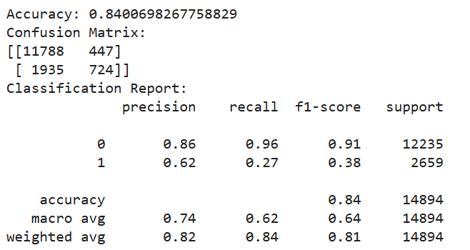
K-Nearest Neighbour

Slide 21
Algorithm comparison
Algorithm | Accuracy | Precision | Recall
Logistic Regression | 85.84% | 0 - 86% 1 - 88% | 0 - 99% 1 - 24%
Decision Tree | 85.73% | 0 - 86% 1 - 86% | 0 - 99% 1 - 25%
Random Forest | 85.80% | 0 - 86% 1 - 86% | 0 - 99% 1 - 25%
K-Nearest Neighbor | 84% | 0 - 86% 1 - 62% | 0 - 96% 1 - 27%

Slide 22
Result
Logistic Regression is the most accurate
Decision Tree performs the same as Logistic Regression
Random Forest performs the same as Decision Tree
KNN performs the worst
All models struggle with identifying collisions

Slide 23
Research Question
Which locations or roads are the deadliest with the highest amount of fatal injuries? Are accidents more likely to occur where there are a lot of accidents that happened in close proximity?
I was hoping that K Nearest Neighbor could identify deadliest concentrations of collisions but it was the least accurate

Slide 24
Continuation/Challenges/Continuity
Not all features have been included in the dataset like gender, speed, alcohol level
Poor data quality and over-fitting may do well on training data but bad on unseen data
Apriori and K Means Clustering to find high risk locations

Slide 25
Conclusion
In this project, several machine learning classification models have been employed to predict collision probability based on historical road collision data. Decision tree and logistic regression exhibit the highest performance at 85% in accuracy score and the decision tree outscore the other by a little bit.

Slide 26

Questions

